Slide 1

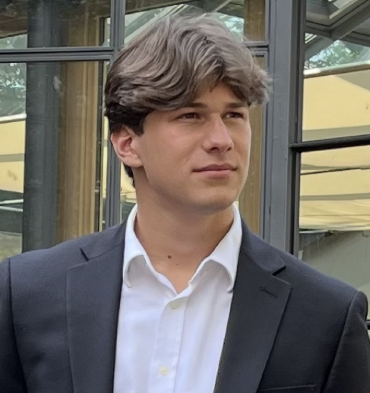
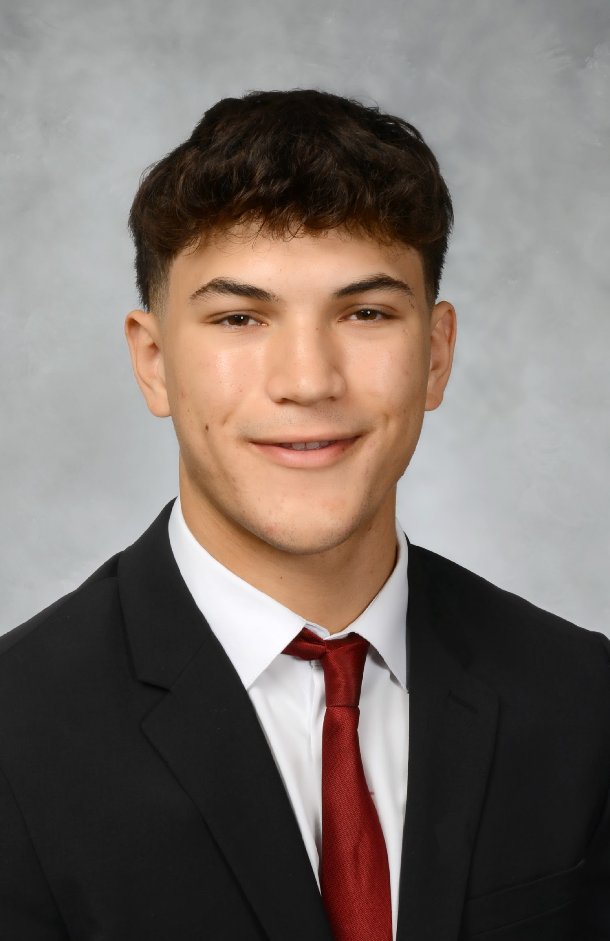

Academic & Task Calendar Assistant — BTE 440 Group 3
Leonardo Rastelli
Jonathan Bergbaum
CEO
COO
Ma. Andrea Mendez
Alex Eng
CMO
CSO

Slide 2
Problem Statement & Business-Tech Impact
Problem Statement
Students juggle deadlines across Canvas, email, Google Calendar, and Slack with no unified, queryable view
Existing calendar/LMS tools store events but cannot answer natural-language questions about workload or priorities
Missed deadlines in a single course can cost a full letter grade; in a work setting, a missed deliverable cascades into lost revenue and trust
Context-switching between tools is measured in hours per week per student — a concrete productivity tax that RAG can directly remove
Business-Tech Impact
Time cost: ~3–5 hrs/week per student lost to triaging deadlines across tools
Risk cost: missed deadlines directly affect grades, scholarships, and (in industry) client SLAs
Opportunity cost: attention spent on logistics is attention not spent on the actual coursework or deliverables
Notes:
Students and professionals struggle to manage deadlines, assignments, and meetings across multiple platforms, leading to missed deadlines, inefficient time management, and reduced productivity. Most current tools only store information but do not help users prioritize tasks or anticipate workload conflicts. This results in decision fatigue, increased stress, and lower efficiency in both academic and business environments.

Slide 3
Target Users & Use Cases
Primary Users / Stakeholders
Undergraduate and graduate students with 4–6 concurrent courses — our primary persona and MVP focus
Instructors and TAs (secondary) — aggregate view of class workload across their students
Early-career professionals with multi-project workloads — Phase 2 expansion after the student MVP
Key User Tasks the System Supports
“What’s due this week?” — natural-language query returns a ranked, grounded list with source citations
“What should I work on next?” — prioritized recommendation using due-date, weight, and estimated effort
Add/edit events via a form or a parsed free-text entry (e.g., “BTE 440 final, May 8, 2pm”)

Slide 4
Scope
What the Application Will Do
Ingest events three ways — NL Quick Add (free-text parse), manual form, or PDF syllabus import — into a JSON API store with an inline embedding vector per event
React + Vite bento dashboard: weekly AI briefing, calendar with workload heatmap, RAG chat with follow-up chips, and guided onboarding tour
Gemini-powered AI features: assignment Break Down, priority + hours enrichment, conflict detection, and responseSchema-validated JSON on every call
Live Profiling dashboard: every AI call logs latency, token count, and USD cost in real time for evaluation and cost tracking
What the Application Will NOT Do
No PII storage — no passwords, bank info, health records, or graded work content
Not in MVP: LMS/Canvas API integration and multi-user accounts (single-user demo only)
No Google Calendar or Outlook write-back in MVP — read-only ICS export only
Does not give financial, legal, or medical advice; will not auto-send email or Slack on the user’s behalf

Slide 5
Data
What documents/data will we use?
Primary Data
User-generated calendar events (assignments, exams, meetings, deadlines) plus a synthetic seed set of ~200 events for eval
Three ingestion paths: manual form, NL Quick Add (free-text parse), or PDF syllabus import
Phase 2 Data (not in MVP)
Profiling log stream: every AI call records query, latency_ms, tokens, and cost_usd for the metrics dashboard
LMS/Canvas API pull for assignment deadlines once auth flow is designed
Google Calendar / Outlook read sync (read-only, no write-back in MVP)
How will we organize sources and any metadata?
Structured store: JSON API (Express) persists events; each event carries an inline embedding vector for in-memory cosine-similarity retrieval
Per-event metadata schema (Gemini responseSchema-validated):
event_id, title, description, due_datetime, course/project, category, weight, est_effort_hrs, priority, status, source
Constraints
Dataset is small and user-owned — no third-party copyrighted content ingested
Data quality depends on what the user enters; parser must surface low-confidence fields
Licensing: user data stays local; no events are shared outside the user session
Privacy: no PII is required beyond event text the user opts to enter
Scale: designed for single-user datasets (<10K events) — no multi-tenant concerns in MVP

Slide 6
System Overview
UI (React + Vite)
Preprocessing and Structuring
Vector Store (inline embeddings)
LLM Response Generation
Bento dashboard: NL Quick Add, PDF import, weekly briefing, RAG chat
1
2
3
4
5
6
7
8
Event Ingestion Module
Embeddings
Generation
Retrieval Layer
Formatted Output
Events stored in JSON API; Gemini enrichment adds hours + priority
Event details converted into embeddings
Top-K events via in-memory cosine similarity

Slide 7
Core Design Decisions
Chunking Strategy
Each event = one chunk; Gemini text-embedding-004 vector stored inline on the event
No overlap needed — events are atomic; embedding covers title + description + category
Average chunk size: 50 - 200 tokens (short event descriptions)
Retrieval Configuration
Top-k retrieval: k = 5 by cosine similarity over in-memory embedding vectors
Filtering by
Date range (e.g., “this week”)
Category (Academic, Work, Personal)
Priority level
Output Format
Natural-language response
Gemini responseSchema-validated JSON for every structured AI call
{
“upcoming_tasks”: [...],
“conflicts_detected”: false,
“priority_flag”: “High”
}

Slide 8
Evaluation Plan
What “good” means
The system will be considered successful when
Retrieved events match the user’s query intent (relevant deadlines shown).
AI responses accurately reflect stored calendar data (no hallucinated events).
High-priority and near-term deadlines are surfaced correctly.
p95 end-to-end latency < 5 seconds, measured live by the Profiling dashboard.
Metrics we’ll track
Retrieval Metrics
Precision@k ≥ 0.8 (top-k results are relevant)
Recall@k ≥ 0.9 (no important events missed)
Date-filter accuracy (Does “this week” return correct range?)
Faithfulness / Grounding
Grounding rate ≥ 0.95 (responses strictly match stored data)
Hallucination rate ≤ 0.05 (invented events flagged and blocked)
Human Evaluation Protocol
4 team members independently grade 20 held-out queries on a 1–5 rubric
Rubric dimensions: relevance, grounding, priority correctness, clarity, latency feel
Sample regression queries: “What’s due tomorrow?”, “Any conflicts next week?”, “Highest-priority task?”

Slide 9
Cost/Latency & Reliability Plan
What We Will Log
The Profiler wrapper logs every AI call in real time:
Token count per call (input + output), streamed to the Profiling dashboard
USD cost per call, computed from Gemini pricing and accumulated in the dashboard
Latency per call (embed, retrieve, generate) for p50/p95 tracking
Success/failure status per feature (Quick Add, Break Down, Weekly Agenda, RAG Chat)
Target:
Response time < 5 seconds
Low-cost usage (small context window, top-k ≤ 5)
Guardrails
To ensure system reliability:
Limit top-k retrieval to avoid excessive token usage
Apply metadata filtering before LLM calls (reduce unnecessary context)
Retry mechanism for failed API calls
Graceful fallback:
If LLM fails → return structured event list directly
Disable retrieval when confidence is high (e.g., simple date filter queries)
Citation check: every event ID referenced in the response must appear in the retrieved top-k set — otherwise the response is rejected and regenerated
Grounding verifier re-checks every cited event against the JSON API before the response is rendered

Slide 10
Demo Walkthrough
Scenario 1: Weekly AI Briefing + Heatmap
Open dashboard: Gemini generates a 2-3 sentence weekly briefing on load
Calendar shows workload heatmap under each day; conflict banner flags overlapping deadlines
Output: briefing text + event count + total hours + color-coded heatmap strip
Scenario 2: NL Quick Add + Break Down + RAG Chat
Type “CS midterm Friday at 3pm” → event parsed, enriched with hours + priority
Click Break Down → Gemini splits assignment into ordered sub-tasks with due dates
Ask RAG Chat: “What’s due next week?” → grounded answer + follow-up chips to dig deeper
What Success Looks Like Live
Response renders in under 5 seconds end-to-end
Every cited event traces back to a row in the JSON API (no hallucinated events)
Priority ordering matches a human grader’s intuition on at least 4 of 5 test prompts

Slide 11
Related Work & Benchmarks
What We Borrow From Existing Tools
RAG knowledge assistants (LangChain, LlamaIndex demos) — retrieval-augmented generation pattern, top-k retrieval with metadata filters, structured prompting with source citations
Productivity & scheduling tools (Google Calendar, Notion, Todoist) — event data model, priority tagging, recurrence handling, conflict detection
Academic planners (MyStudyLife, Todoist Education) — course-level grouping, semester views, assignment weighting
What We Do Differently
Prioritization, not just storage — calendars show events; we rank them by weight × urgency × estimated effort and answer “what should I work on next?”
Grounded natural-language interface — every answer cites the specific event IDs retrieved from the JSON API; generic LLM chatbots hallucinate deadlines, we verify against a source of truth
Unified academic + early-career workloads — most planners silo either schoolwork or jobs; our schema treats courses, projects, and meetings as one ranked inbox
Measurable evaluation rubric — precision@k, grounding rate, and human relevance scoring, not just “does the UI look nice”

Slide 12
Milestones
Week | Milestone | Tasks | Dependencies
Week 1 | ✅ Scope Lock | Define scope, cut MVP (Leonardo) | —
Week 2 | ✅ Architecture Design | Pipeline + data flow (Alex) | Scope locked
Week 3 | ✅ Component Selection | Gemini API, inline embeddings, JSON API (Alex + Jon) | Architecture frozen
Week 4 | ✅ UI Mockup | React + Vite bento wireframes (Andrea) | Scope finalized
Week 5 | ✅ Eval Rubric Drafted | Metrics + human protocol (Alex) | Components picked
Week 6 | ✅ Synthetic Dataset | 20 sample events + gold answers (Jon + Leonardo) | Schema fixed
Week 7 | ✅ Build Sprint | All 8 features shipped: Quick Add, Break Down, Agenda, Chat, Tour (all) | Design frozen
Week 8 | ✅ Demo Prep + First Eval | Onboarding tour, Profiling dashboard live, QA pass (Leonardo + Andrea) | Build complete

Slide 13
Risks and Open Questions
Top 3 Risks
Data Quality
Retrieval Relevance / Grounding
Deployment Constraints / Latency
Questions for Instructor Feedback
1. Scope
Are optional features like PDF syllabus extraction or semantic prioritization appropriate for this project scope?
2. Dataset Assumptions
Is it acceptable to rely solely on user-generated events and small synthetic test datasets for evaluation?
3. Evaluation Thresholds
Are our proposed metrics (precision@k, grounding checks, human rubric) sufficient, or should we include additional evaluation criteria?

Slide 14
Next Steps
What’s next after the MVP demo
1. Canvas / LMS Integration
Auto-sync deadlines from Canvas so users don’t hand-enter anything
Two-way sync: changes in the app push back to the LMS calendar
2. Multi-user Accounts
Replace single-user JSON store with Postgres + auth (e.g., Clerk or Supabase)
Per-user embedding stores; shared study groups with scoped RAG
3. Proactive Notifications
Email / push digest: “Tomorrow looks heavy — here’s what to tackle tonight”
Conflict banner triggers an SMS nudge when two assignments collide
4. Expanded Evaluation
Regression set of 100+ real syllabus queries, run nightly
Profiling dashboard grows into a full model-vs-model A/B testing surface

